Slide 1
Hash Tables
Programming – Code Design and Data Structures

Slide 2
Contents
Hash Tables
  Basic Implementation
Hash Table Collisions
  Separate Chaining
  Open Addressing
    Probe Sequences
Hash Table Efficiency
Hash Table Resizing

Slide 3
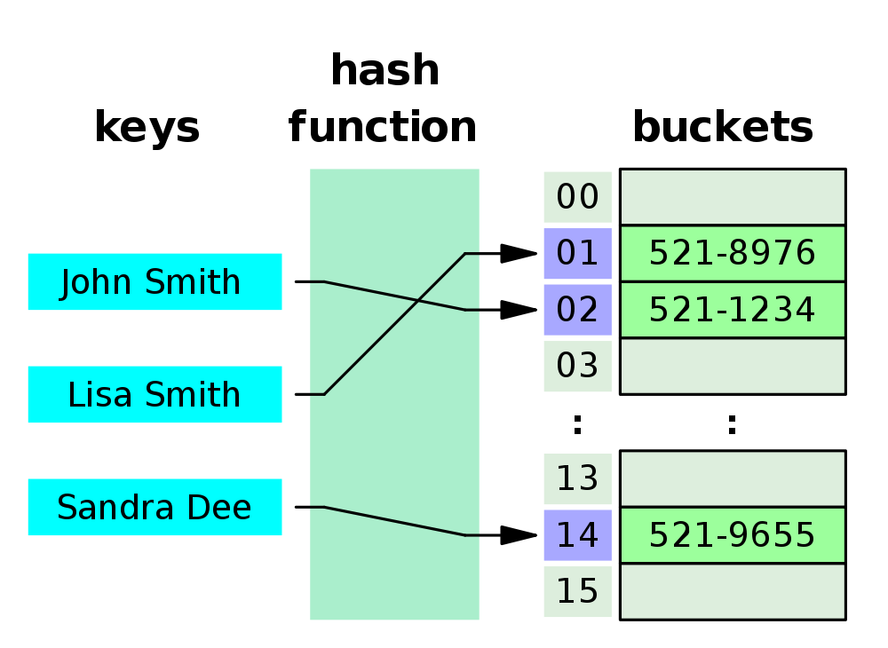

Hash Tables
A Hash Table is a form of container
  Similar in functionality to a dynamic array
  Stores values within buckets using a hashed key as the index
  This allows for the use of non-integer keys, such as a string, for the table index
Using a hashed integer version of the key results in near $O(1)$ lookup times
  This is best-case as it is implementation dependent

Slide 4
Basic Hash Table Implementation
A basic implementation for a Hash Table consists of an array of hashed items
  When adding an entry we first hash the key to get an index into the array
  Since the result of the hash will most likely be outside of the range of the array we need to clamp it to fit
    A simply approach would be to modulus the hash value
  We then access the entry in the array that the hashed index refers to
// create a table of 100 entries of GameObject pointers
unsigned int tableSize = 100;
GameObject** hashTable = new GameObject * [ tableSize ];
// add an entry for “Jason Todd” by first hashing the key
unsigned int hashedKey = hash(“Jason Todd”);
// make the key fit the range
hashedKey = hashedKey % tableSize;
// add a value at the key’s location
hashTable[ hashedKey ] = new GameObject(“Robin”);
An example of a Hash Table containing GameObject pointers

Slide 5
Basic Hash Table Implementation
template<typename KeyType, typename T>
class HashTable {
public:
HashTable(unsigned int size)
: m_size(size), m_data(new T[size]) {}
~HashTable() { delete[] m_data; }
T& operator [] (const KeyType& key) {
auto hashedKey = hash( key ) % m_size;
return m_data[ hashedKey ];
}
const T& operator [] (const KeyType& key) const {
auto hashedKey = hash( key ) % m_size;
return m_data[ hashedKey ];
}
private:
// ideally this would be a std::function
// specified as a template parameter
unsigned int hashFunction(const KeyType& key);
T* m_data;
unsigned int m_size;
};
We could also implement this as a template container
  You would need a way to specify the Hash Function for the container to use when hashing keys
    This could be done using a template parameter for a std::function
In many cases the key will typically be a string
  Rather than specify a KeyType template parameter we could simply use std::string where appropriate

Slide 6
Hash Table Collisions
In the previous basic implementation there was nothing to handle Collisions
  Collisions are when two different keys give the same Hash Value
Given the limited size of the Hash Table array the problem is compounded
  Although the result of the Hash Function can give a large varied integer value, because of the modulus we are reducing the results to an even smaller range
  Two keys may give different Hash Values, but once we apply the modulus they may be the same!
There are a few ways collisions are handled in Hash Tables

Slide 7
Hash Table Collision Handling
In all cases where collisions are to be handled, the Key must be stored along with the Value within the Hash Table
  Can be done using a pair structure
Two common methods for handling collisions are
  Separate Chaining
  Open Addressing
template<typename A, typename B>
struct Pair {
A first;
B second;
};

Slide 8
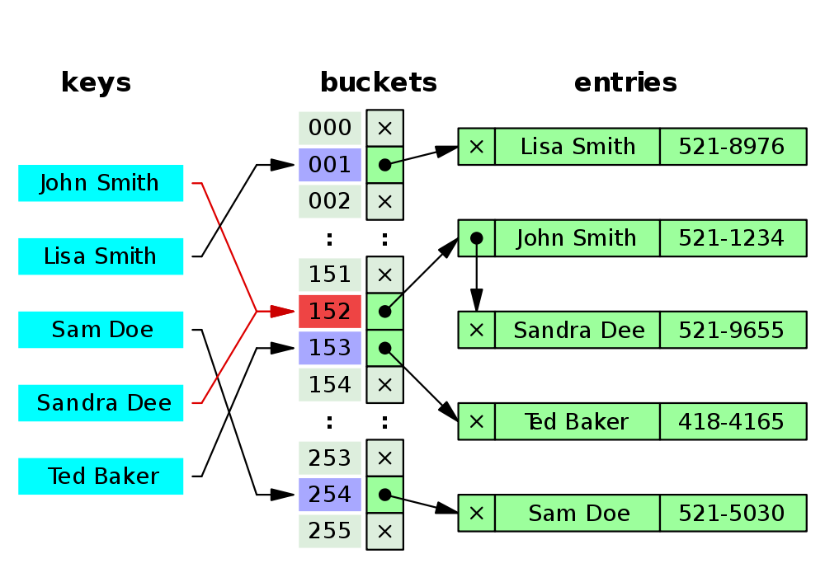
Hash Table Collision Handling
Separate Chaining is a method where each entry in the Hash Table is a list of some kind
When adding an entry
  Add the entry to the list at the index of the key
When searching for an entry
  Find the index for the key
  Search the entries in the list at the index by comparing the stored keys to find the correct entry
Example Separate Chaining Hash Table storing phone numbers based on names

Slide 9
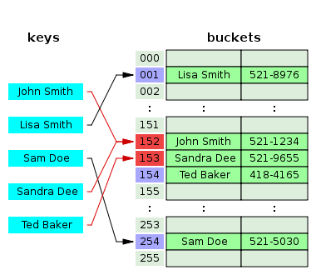
Hash Table Collision Handling
In Open Addressing, an entry might not be located at the index of its Key!
When adding an entry
  The table indexes are probed, using some defined probe sequence, starting at the hashed index of the Key, until an empty bucket is found for the new entry to populate
When searching for an entry the same process is followed
  We search for the value that has a matching Key using a probing sequence, starting at the hashed index, until the item is either found or does not exist within the table because no match is found

Slide 10
Open Addressing Probe Sequences
Probe Sequences are simply a method of deciding which index to check next in Open Addressing
  If the index of a hashed Key is not the entry we’re looking for, then we jump to a different index based on some pre-defined sequence
Common methods include:
  Linear Probing – we jump a specified number of indexes, usually an interval of 1, until an empty bucket or the searched-for entry is found
  Quadratic Probing – similar to Linear, but uses a quadratic polynomial function for the interval
  Double Hashing – the interval to jump is specified by a secondary hash function
In this example, Linear Probing of interval 1 is used. Although Ted Baker has a unique hash index its bucket already contains Sandra Dee, so Ted is bumped 1 along.

Slide 11
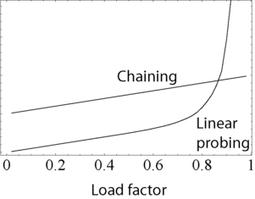
Hash Table Efficiency
Hash Tables are considered “efficient” if they have a Load Factor of 70-80%
  Load Factor is a measure of how full the table is
  Load Factor = entries in table / size of array
If the Load Factor for a Hash Table becomes too large then the access time for the table can slow down
  Different collision handling methods also perform differently based on the Load Factor
A comparison of collision handling techniques at different Load Factor levels (lower is better).

Slide 12
Hash Table Resizing
We can resize a Hash Table if its Load Factor becomes too large
When the Load Factor becomes to large we could simply
  Create a new, larger array
  Copy all old entries into the new array by re-hashing them into it
  This can be extremely slow for large tables if done all at once!
Another approach may be to only add new entries to the new larger hash table and keep the old smaller table
  Each time we add a new entry we could also move over a certain number of old entries until the old smaller table is empty, then remove it
  Or, if we are implementing the hash table within a game, we could move over a certain number of entries each frame until the old smaller table is empty

Slide 13
Summary
Hash Tables are a way of storing data based on hashed keys
  Keys are often strings, such as file names in the case of Resource Managers
  A good Hash Function is needed to reduce Collisions
Hash Collisions must be handled appropriately
  Various methods exist, each with different advantages and disadvantages
  Hashed Values usually clamped to a smaller array size causes collisions often
Hash Table Load Factor should be kept low to reduce collisions
  70-80% or less is ideal
  Tables can be resized if needed to reduce Load Factor

Slide 14
Further Reading
Eric Suh, Hash Tables at cprogramming.com
  http://www.cprogramming.com/tutorial/computersciencetheory/hash-table.html
Wikipedia, Hash Table, Wikimedia Foundation Inc.
  https://en.wikipedia.org/wiki/Hash_table

